Slide 1

Introduction to SOA & Services ADM Insurance BSM

Slide 2
Introduction
Purpose of this Document:
Introduce the concept of Services and Service Oriented Architecture, specifically within Lloyds Banking Group, from the perspective of ADM Insurance – BSM
Topics include:
Web Services
ESB – Enterprise Service Bus
CIM – Common Information Model
DataPower, MessageBroker, MQ
Systinet
Overview of the Group IT E2E Project Lifecycle from the perspective of a Service Designer, including various platform deliverables
Target Audience:
Anyone wanting to know more about Services, SOA, Middleware or Service Design.
For example new colleagues working in BSM (contractors, partners, permanent colleagues, either new to the role or new to LBG) or other platform teams that may work closely with BSM and want to get a better understanding of what the Services team delivers
Author:
Richard Thurston (ADM Insurance – BSM)
richard.thurston@lloydsbanking.com
Assisted by:
Ian Bennett (ADM Insurance – BSM)
ianbennett@lloydsbanking.com
Notes:
2

Slide 3
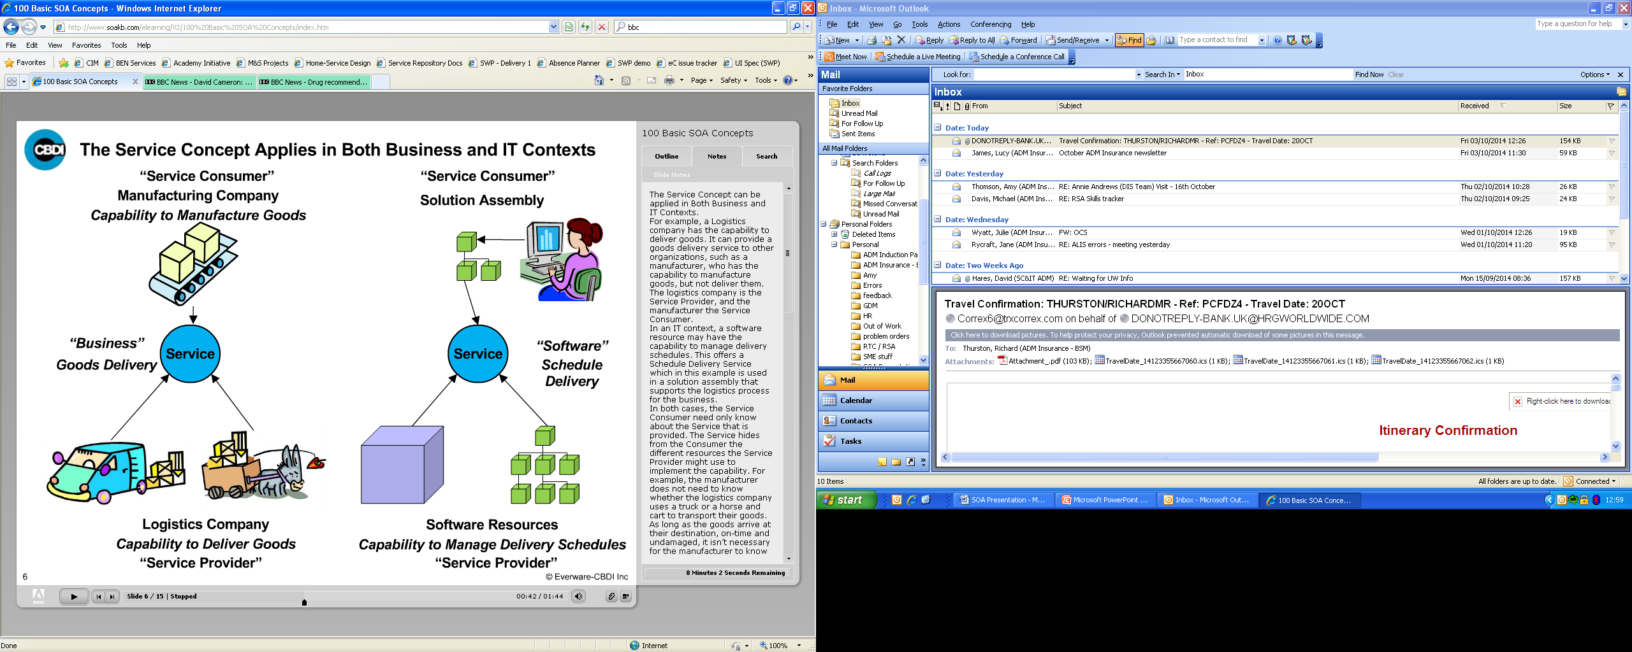

What is a Service?
A service is a logical representation of repeatable activity which encapsulates a business or technical capability, by which the need of a service consumer is satisfied by a service provider.
A service decouples the resources that are used by the service provider to implement the capability, from those used by the service consumer. This leads to increased flexibility and agility.
In both cases the consumer need only know about the service provided, for example the manufacturer does not know whether the logistics company uses trucks or carts, just so long as the goods are delivered. Similarly a solution assembly does not know whether the service resource accessed by the service is running on a large mainframe or a collection fine grained software components – the important thing is the outcome, and that the deliveries are scheduled by the system.
The concept of a service applies to both Business and IT contexts
Service Consumer
Service Provider
Service Consumer
Manufacturing company
Capability to manufacture goods
Service Consumer
Solution Assembly
Providing Resource A1
Service provider can change resources without impacting consumer
Consuming Resource
service
Service consumer need only know about and interact with the service
Providing Resource A2
Focus is on What – not How, Where or by Who
A service hides complexity and virtualises the capability.
It can be transparent to the service consumer how the capability is performed, which resource performs it, whose resource it is, where it is located and how it is implemented.
i.e. consumers need not know or care whether the service is:
- running on linux or mainframe
- written using MessageBroker or Sonic etc
- running on a machine in U.K. or India
By removing the constraints of tightly coupled resources, providers and consumers have greater agility to use alternative resources or vendors - as long as the same service exists.
service
“Business”
goods delivery
service
“Software”
Schedule
delivery
Service Provider
Logistics company
Capability to deliver goods
Service Provider
Software Resources
Capability to manage delivery schedules
A software service provides a mechanism to interact with different resources. The service is independent of these resource types and the technology used to implement it.

Slide 4
What is SOA?
Service-Oriented Architecture (SOA) is the underlying structure supporting communications between services.
It is a software design and software architecture design pattern based on distinct pieces of software, providing application functionality as services to other applications. It contains the policies, practices and frameworks which structure the business and its systems as a set of capabilities offered as services.
“SOA is a software architecture for building applications that implement business processes or services using a set of loosely coupled, black box components orchestrated to deliver a well defined level of service to support both business and IT”
SOA makes it easy for computers connected over a network to cooperate – every computer can run an arbitrary number of services, with each service being built in a way that ensures information can be exchanged with any other service in the network without human interaction and without the need to make changes to the underlying program itself.
Loose Coupling – each component is self-sufficient and has, or makes use of, little or no knowledge of the other separate components.
Black box – a device or system that can be viewed in terms of its input, output and transfer characteristics without any knowledge of its internal workings. It hides the complexity and virtualizes the capability.
An example…
Whether you realise it or not, you may have relied on SOA at some point, for example when you made a purchase online. You look at their catalogue and choose a number of items. You specify your order through one service, which communicates with an inventory service to find out if the items you've requested are available in the sizes and colours that you want. Your order and shipping details are submitted to another service which calculates your total, tells you when your order should arrive and produces a tracking number that, through another service, will allow you to keep track of your order's status and location en route to your door. The entire process, from the initial order to its delivery, is managed by communications between the Web services - programs talking to other programs, all made possible by the underlying framework that SOA provides.
Notes:
4

Slide 5
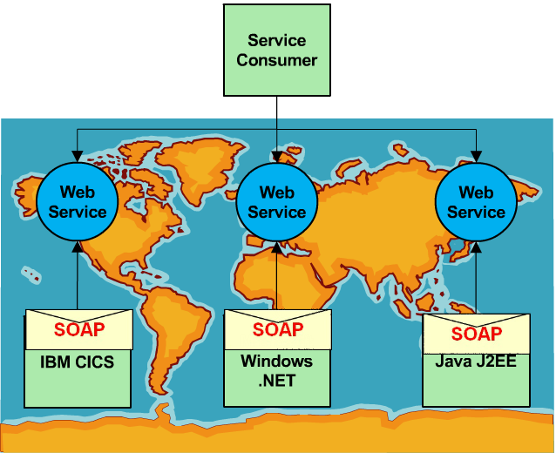
Web Services
Web Service: A software system designed to support interoperable machine-to-machine interaction over a network
It was the emergence of web services that largely drove the subsequent interest in SOA.
The behaviour of a web service is described using Web-Service Protocols and any interaction
with the service is conducted using the same protocols.
WS Protocols:
Provide interoperability between both the service provider and the service consumer across heterogeneous, distributed and federated resources
Are platform independent and transport independent
Are based on open standards – systems communicate using XML (eXtensible Markup Language) and are typically conveyed using HTTP (Hypertext Transfer Protocol)
Key mechanism for technology decoupling so long as software platforms used by the service provider and the service consumer understand web service protocols
Core Web Service Protocols:
SOAP (Simple Object Access Protocol) - protocol for messages
WSDL (Web Services Description Language) - describes a service and its operations. It is also used to locate a service
UDDI (Universal Description Discovery and Integration) – directory or registry where services can be published by the service provider and can be discovered by the service consumer.
Also WS-Security, WS-ReliableMessaging, WS-Policy
RESTful Web Services:
REST (Representational State Transfer) has been
accepted as an alternative to SOAP and WSDL
based web services, and there are four Basic
principles of REST:
Use HTTP methods explicitly
Be stateless.
Expose directory structure-like URIs.
Transfer XML, JSON, or both
(N.B. REST is not currently used by LBG)
Notes:
5

Slide 6
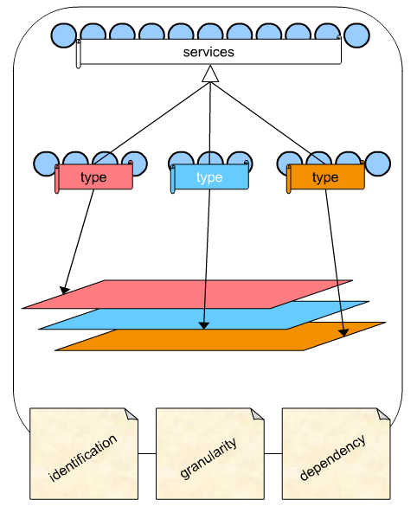
Service Architecture
Focusing too much on the technology side of SOA can result in service anarchy, whereby services are delivered ad hoc with no focus on how well a service meets the objective of SOA in terms of flexibility and sharing for both IT and business. Therefore to manage a potentially complex set of services, they need to be arranged into an architecture in order to improve sharing and reduce duplication, which in turn will increase efficiency and consistency.
Ensuring well formed services
A service must meet the needs of service providers and service consumers
and reduce the dependency between their resources.
This is achieved through a Service Contract
Ensuring well formed architectures
A collection of services should be classified into types, with types arranged
into layers to give a modular architecture.
This is then governed by architectural patterns and policies.
+
=
Well formed services &
Well formed service architecture
Service concepts
Principles / Characteristics
SOA is the general approach to guide the development of Service Architecture.
To ensure consistency and quality of service delivery, the service architecture must adhere to the same set of:
Principles e.g. services classified by type to separate concerns
Policies e.g. services must be assigned to one layer of architecture
Framework e.g. governance framework
Notes:
6

Slide 7
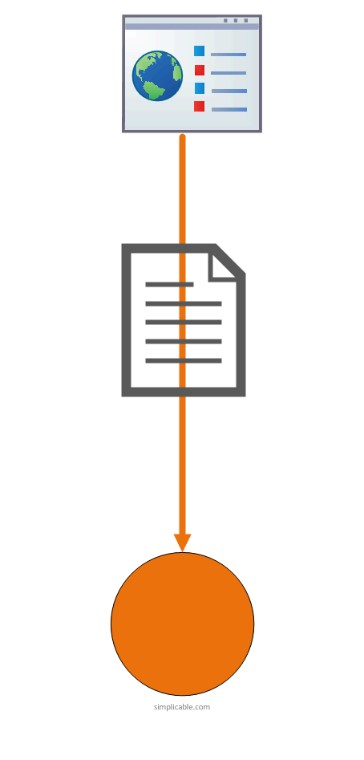
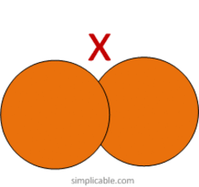

Principles of SOA Principles are key drivers of value
1. Standardised Service Contract
“Formal agreement between service provider and service consumer. Services within the same service inventory must be in compliance with the same contract design standards”
Services are able to define their capabilities and overall purpose in the form of a service contract which stipulates services in the form of a communications agreement that will be defined by one or several service description documents. This principle requires that specific considerations be taken into account when a service’s public technical interface is being designed.
2. Loose Coupling
“Service contracts impose low consumer coupling requirements and are themselves decoupled from their surrounding environment”
Services should be designed so that they are independent, with the dependency minimised between the service contract, its implementation and its consumers. Therefore providers and consumers have greater agility to use alternative resources.
3. Service Abstraction
“Service contracts only contain essential information about services and this information is limited to what is published in service contracts”
By hiding as much of the underlying details of the service as possible it enables a loosely coupled relationship. Furthermore the amount of logic that a service may encapsulate could be limitless.
N.B. These are known as black boxes i.e. we are not concerned with the internal complexity, only its inputs and outputs.
Notes:
7

Slide 8
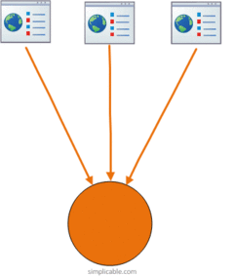
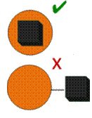
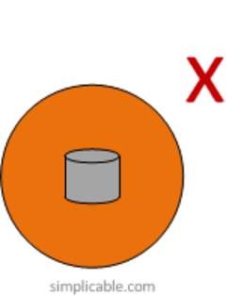
Principles of SOA
4. Service Reusability
“Services contain and express agnostic logic and can be positioned as reusable enterprise resources.”
Logic is divided into services, which in turn should be designed with agnostic functional contexts ensuring individual service capabilities are appropriately defined to facilitate necessary reuse requirements.
5. Service Autonomy
“Services exercise a high level of control over their underlying runtime execution environment.”
For services to carry out their capabilities consistently and reliably, their underlying solution logic needs to have a significant degree of control over its environment and resources.
6. Service Statelessness
“Services minimize resource consumption by deferring the management of state information when necessary.”
Excessive state information can compromise the availability of a service and undermines its performance and scalability potential, therefore services are designed to remain stateful only when required.
Notes:
8

Slide 9
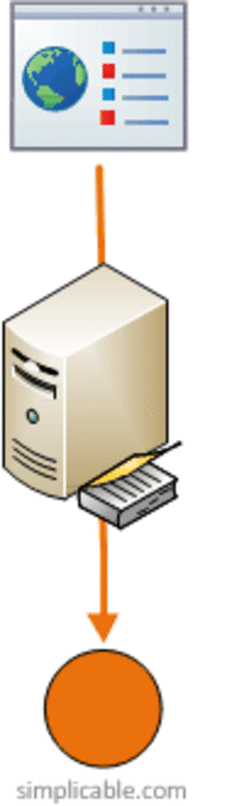
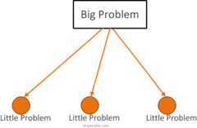
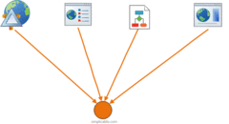
Principles of SOA
7. Service Discoverability
“Services are supplemented with communicative metadata by which they can be effectively discovered and interpreted by service consumers”
Services need to be easily identified and understood when there are opportunities for reuse in order for them to be positioned as IT assets with repeatable ROI. (Service registry / directory)
8. Service Composability
“Services are effective composition participants, regardless of the size and complexity of the composition.”
Services can be composed together to form a larger service, As service portfolios increase in size, service compositions will become an increasingly vital design aspect, therefore services need to participate as effective controllers or members of the compositions.
9. Service Interoperability
“Services are interoperable”
Services should use standards that allow diverse subscribers to use the service. This may not be recognised as a principle in its own right since it is fundamental to every other principle and is so obvious it should be a natural by-product of service orientation.
Notes:
9

Slide 10
SOA Overview
Services are unassociated, loosely coupled units of functionality that are self-contained. They can be combined by other software applications to provide the complete functionality of a large software application. Each service implements at least one action, such as retrieving an online bank statement or modifying an online booking.
Within SOA, services use defined protocols that describe how services pass and parse messages using description metadata, which describes not only the characteristics of these services, but also the data that drives them.
The metadata should be provided in a form that software systems can use to configure dynamically by discovery and incorporation of defined services, and also to maintain coherence and integrity. For example, metadata could be used by other applications, like a catalogue, to perform auto discovery of services without modifying the functional contract of a service.
The metadata should be provided in a form that system designers can understand and manage with a reasonable expenditure of cost and effort.
Programmers have made extensive use of XML in SOA to structure data that they wrap in a description-container – the WSDL describes the services themselves, while SOAP describes the communications protocols.
The purpose of SOA is to allow users to combine together fairly large chunks of functionality to form ad hoc applications built almost entirely from existing software services. The larger the chunks, the fewer the interfaces required to implement any given set of functionality; however, very large chunks of functionality may not prove sufficiently granular for easy reuse.
Each interface brings with it some amount of processing overhead, so there is a performance consideration in choosing the granularity of services.
SOA as an architecture, relies on service-orientation as its fundamental design principle. If a service presents a simple interface that abstracts away its underlying complexity, then users can access independent services without knowledge of the service's platform implementation.
Notes:
10

Slide 11
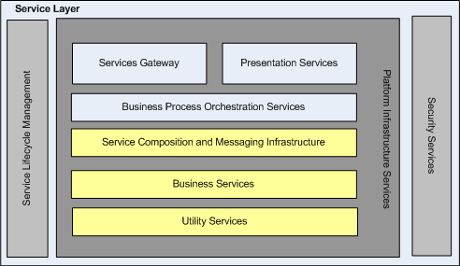
Service Component Architecture
Branch
Telephony
Digital
User Interface (UI) Services & Gateway (Façade) Services.
Channels
BU
Multi-Channel
PAYMENTS
MORTGAGES
LP&I
Business Process Technologies
Other
BUs
Orchestration Service, contains the flow of various business service invocation to deliver a Business process.
Coarse-grained Business Service composed out of several fine-grained services.
Fine grained Business Services, Could be used standalone or composed along with other services to delivery coarse-grained Business service.
Low Level Underlying/Utility services, reused across most of the Business Services.
Security Services to provide security feature across all level of services
CBS
ALS
External Parties
Backend
Systems
Support process/service to manage service lifecycle (via Systinet)
OCIS
Others
Experian
Notes:
11

Slide 12
Benefits of SOA
Aligns IT with the Business
The capability of IT is aligned to the requirements of the business with full visibility of business concepts throughout the lifecycle
Abstraction moves focus away from application-specific complexities which allows IT to concentrate on solving business problems, rather than technical ones – there is a greater emphasis on Business Analysis, data modelling, data analysis and Model Driven Development than on application development
Reduced risk – improved governance ensures policies and standards are met which satisfy regulatory compliance
Services naturally align to business processes – for example if a HR Department hires a new employee, a service will be required to add the new employee’s ID to the colleague database: HR Department – Hire employee
IT service – AddEmployeeId operation
Maximise benefits of legacy applications
Old architectural approaches that once expanded business can now limit growth and become outdated. However existing systems cannot simply be replaced as this would be too costly, therefore SOA can be used to reduce the cost of integrating legacy systems with the rest of the architecture which will extend the useful life of legacy systems.
SOA gives existing systems the flexibility and agility to respond to a business environment which is continuously changing - For example a legacy application might have been isolated, and would perhaps have to be closely-coupled to another application to make its information available, but now it can be integrated fairly cheaply and in a standard way.
Expose functionality via open standards using adapters – adapters may have to be provided by third parties (e.g. Shadow) if the original vendor does not support it. This is possible for most technology platforms, for example, LBG uses CICS to bolt on a new web service onto some monolithic application so that we can now use this legacy system in our architecture.
Services are granular (broken down into smaller units of functionality) – they no longer monolithic applications
It allows legacy applications to continue to do what they do best.
Notes:
12

Slide 13
Benefits of SOA
Simplify Development
Reduced complexity of integration - It helps organisations transform their business processes for high performance by simplifying the underlying information systems. It becomes easier to map how we will pull together the information needed, which allows us to take a business requirement and create a service which will satisfy it.
Loose coupling enables myriad different systems to supply information in a consistent way therefore an organisation can concentrate on which applications to integrate, rather than how to do it – instead of connecting the consumer directly to the provider, we add a service in the middle and are only concerned with the inputs and outputs, not how it will be done.
Simplification leads to reduced costs
Architectural Benefits
Use of industry open standards (XML, SOAP, WS-*) and standardised data model within ADM Insurance (CIM)
Services that follow standards are inherently interoperable which makes it easier for applications to exchange information and leads to increased agility
Discoverability – service registry
Improved Quality of Service – monitoring, security, integrity
Increased vendor diversification options – although individual services may require vendor-specific technology, the architecture will usually not, therefore vendors can be substituted, with the same services in place.
All these factors mean that people (architects, designers, developers, testers) will have a common expectation and understanding of how things should work
Improved Governance – management, policies and processes ensure desired outcomes are achieved and risks are properly controlled e.g. service contract, SLA and progressive reviews throughout the project lifecycle, independent of which phase it is in.
Increased Federation – resources are united while maintaining their individual autonomy and self governance - each application is free to do what it does best with the service in place to link them together in a meaningful architecture.
Notes:
13

Slide 14
Benefits of SOA
Software Reuse
A service inventory establishes a pool of services, many of which will be deliberately designed to be reused within multiple service compositions.
Modularity – provides reusability which drives consistency, lower cost, and flexibility
Reliability – A key non-functional aspect of shared services is that a single service may support many consumers.
Scalability – implementation must be scalable to allow additional consumers to use the Service over time
Reduced cost in terms of maintenance as well as development – Maintenance costs are reduced if something is reused, as there is only one thing to maintain rather than two
Composability – services are not just reused in the way they were initially intended, but can be composed into other services i.e. a part of a service can be used when creating a new service without having to start design from scratch.
However…
Building reusable services can be more costly in the short term, with the benefits being realised in the longer term as services get reused in other solutions – Projects which are responsible for defining and implementing the initial version of a Service may be impacted by additional cost and time when compared against a tightly coupled architectural style. However, as the Service matures it’s functional scope will match the majority of requirements and subsequent projects will benefit from both reduced cost and decreased delivery times – in the long term, the business will see a Return on Investment (ROI)
SOA Goals
Business Goals
Reuse
Reduced complexity
Reduced risk
Ensure policies and standards are met
Agility / business response
Standardisation
Reduced cost
Regulatory compliance
Notes:
14

Slide 15
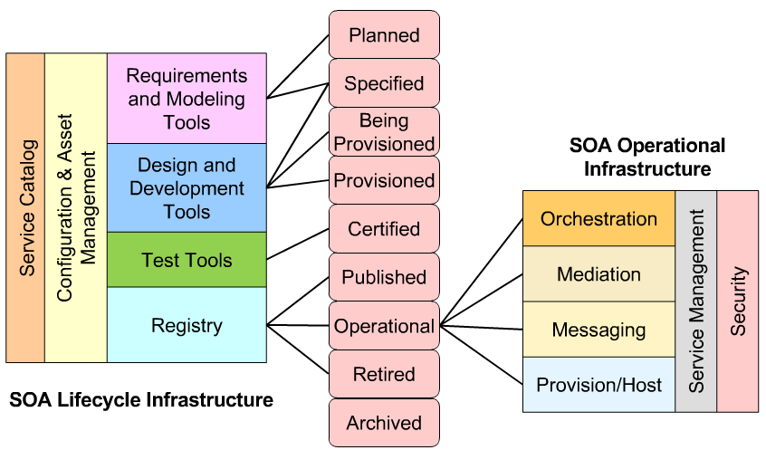
Key Infrastructure Capabilities for SOA
Service Lifecycle
Initiation, Study, Design, Build, Test, Implement
Service State
ESB that drives SOA at run time
SOA Operational Infrastructure
Service Catalogue supporting the full Service Lifecycle
Service and Systems management that ensures delivery of SLA
Notes:
15

Slide 16
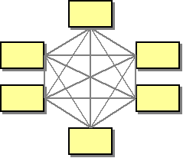
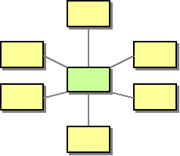
Enterprise Service Bus
An ESB can be either a logical implementation pattern or a physical product which implements the pattern.
The functionality provided by an ESB is the decoupling of the Service Requester from the Service Provider and any mediation required for the two to interoperate, for example message format, transport protocol, service granularity (through composition of finer grained Services) and security - see next slide.
Direct part-to-part messaging
ESB to act as a broker
Benefits of using an ESB:
It decouples the consumer and provider by inserting an active mediator in the middle which routes incoming messages to the correct destination (having all messages travel though a central component is also great for logging messages or to control message flow)
It reduces the number, size, and complexity of interfaces.
It reduces the impact of changes that are made to the format and location of Services, both in terms of impact to the applications and in terms of system management.
It enables integration between disparate resources.
It allows substitution of one service provider for another without the consumer being aware of the change or without needing to alter the architecture to support the substitution.
(Front-end)
Consumer
(Back-end)
Provider
(Front-end)
Consumer
ESB
(Back-end)
Provider
Another Perspective…
Hub and Spoke Architecture
For n systems to be connected we will end up with n/2 *(n-1) for 8 systems we will end up with 28 channels. As well as the channels, every system has to remember the connection details, message exchange format and message transport protocol details of other systems. This would result in a more complicated and less maintainable architecture, as it would increase the over head to the
development and application support teams when future systems are added, therefore making it less scalable.
Therefore a broker (e.g. MessageBroker or Sonic) may be used to act as a mediator between these systems which all communications have to go through. When System A wants to call System B, A will call the broker, which in turn will call B. The Broker effectively becomes a Hub with all the systems connected to it in a spoke-like fashion - this reduces the number of channels from 28 to 8.
Notes:
16

Slide 17
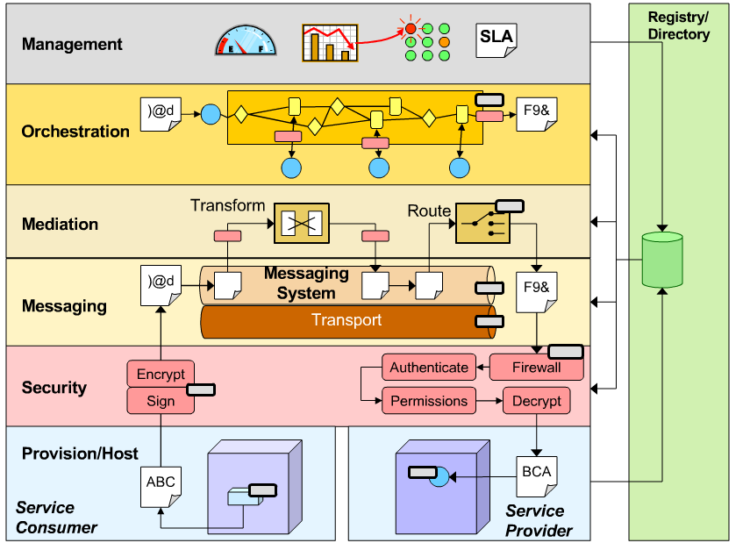
SOA Operational Infrastructure
ESB
Notes:
17

Slide 18
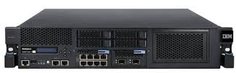
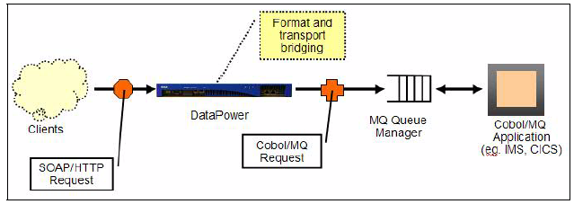
DataPower
WebSphere DataPower is an appliance-based ESB and is built for simplified deployment and hardened security.
It is described by IBM as a ‘SOA appliance’ and is a physical device (actually a family of devices), with the form factor of a rack-mounted server. Its capabilities are built into its firmware, and are configured via a browser interface.
Single device with many functions - Service level management, dynamic routing, policy enforcement, transformation
Higher levels of security assurance certification - FIPS140-2 Level 3, Common Criteria EAL4,Kerberos etc.
It has no branded operating system - the device is maintained by firmware updates rather than operating system updates and patches.
LBG uses the XI50 model appliance, which has the following capabilities:
Can be used as a web service proxy and/or a security gateway – support includes XML/SOAP firewall and threat protection, field-level XML security, data validation (conformance against service contact - WSDL and schema - XSD) among other things.
Can process and route messages at wire speed, including XML, XSLT transformations, XPath and XSD schemas.
Can switch between various messaging protocols e.g. HTTP(S), MQ, SSL FTP, JMS
Protocol and formal bridging example
At LBG, DataPower appliances can reside in the 'White Zone', for use in internal applications, or the 'Amber Zone', for use in B2B/C2B applications (e.g. LBG Ecommerce sites or internet users such as insurance aggregators).
Notes:
18

Slide 19

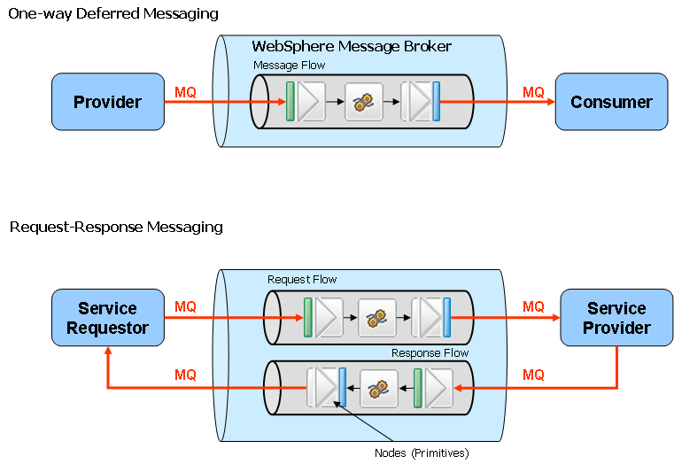
MessageBroker
WebSphere Message Broker is an Enterprise Service Bus (ESB) which provides connectivity and universal data transformation for a Service Oriented Architecture.
It can integrate an enterprise consisting of heterogeneous systems (channels, back-ends) that are standard and non-standard based applications, protocols and data.
It dynamically routes and transforms data, allowing interoperability of heterogeneous systems.
It can connect almost any application or service over multiple protocols including SOAP, HTTP, Java Message Service (JMS) and more.
It is used for Services/Service Operations requiring message transformation, mediation and orchestration. Therefore it is ideal for the creation of ‘services’ in a Service Oriented Architecture, as the client invokes a single service API and the broker performs all the complicated processing behind the scenes.
N.B. These orchestrations, or 'message flows‘ are coded and tested in advance by developers (to suit the business requirements of the individual services) using the broker's own development toolkit and programming language, and then deployed to the broker servers.
IBM WebSphere Message Broker is a powerful information broker that allows both business data and information, in the form of messages, to flow between disparate applications and across multiple hardware and software platforms.
Orchestration logic can be applied to the data that is flowing through the message broker in order to route, store, retrieve, transform and enrich the information.
Message Broker layer provides a level of abstraction which offers the service to the consumers whilst shielding them from the complexity of its delivery.
Message Broker requires MQ to form the Broker’s internal transport protocol. Alternatively it can use adapters created by IBM or third parties
Example orchestration:
Host 1
Host 2
SOAP/HTTPS
XML/MQ
DataPower
Message Broker
Orchestration/Message enrichment
SOAP/HTTPS
SOAP/HTTPS
SOAP/HTTPS
Consumer
SOAP/HTTPS
DataPower
Notes:
19

Slide 20

WebSphere MQ
WebSphere MQ provides assured one-time delivery of messages across a wide variety of platforms
e.g. Windows, Linux, OS/2, mainframe and Unix.
It emphasizes reliability and robustness of message traffic and ensures that a message should never be lost if MQ is appropriately configured.
It provides a mechanism to achieve non-time-dependent architecture where messages can be sent from one application to another, regardless of whether the applications are running at the same time.
If a message receiver application is not running when a sender sends a message to it, the queue manager will hold the message until the receiver asks for it – MQ acts as a lightweight database
Ordering of all messages is preserved, by default this is in FIFO (first in - first out) order of receipt at the local queue within priority of the message.
Front-end:
HTTP
Orchestration context:
MQ will maintain the state of the request message
Response
Data
Power
MessageBroker
Middleware:
MQ
MQ
MQ
Back-end:
ALIS
QDS
MessageBroker is built on MQ and uses it internally to transport messages. It also extends the capabilities of MQ by adding support for other protocols, including real-time Internet and intranet etc.
Notes:
20

Slide 21

HP Systinet
HP SOA Systinet is a strategically aligned Service Registry and Repository software provided by HP
Existing Registry and Repositories (e.g. Websphere Registry and Repository, Lotus Notes, Access Database and MS Excel) had various limitations:
Key Benefits of Systinet:
Single Group IT Enterprise Repository and catalogue for services and artefacts
Service discovery, publication (registration) and reuse
Automated service dependency management and versioning
Powerful visualization tools for service modelling and change management
Workflow driven governance lifecycle processes
Federated repository domains to support distributed development
Extensive customisation of search capability and user interface
Browser based GUI and Eclipse based Plug-in for Rational
Report generator to measure success against KPIs.
Aging technology
Usability
Service lifecycle enforcement
Duplication of information
Restriction to extent to meet changing requirements.
HP SOA Systinet
Publish and Discover Services
Understand Impact and Manage Change
Validate Service Conformance
Create Consumer / Provider Contracts
Govern Service through Lifecycle
Manage and measure delivery of Portfolio
Enterprise Service Repository
Central Store for all Services and Artefacts
Notes:
21

Slide 22
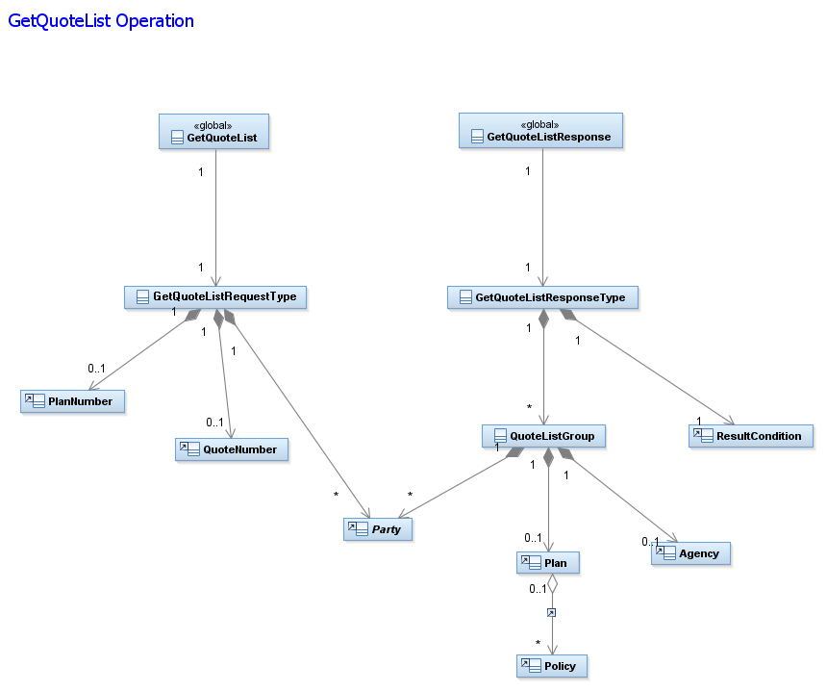
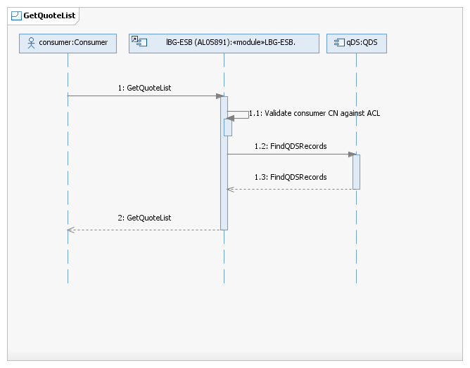
Common Information Model
The CIM is an LBG standard that defines how managed elements in an IT environment are represented as a common set of objects and relationships between them. This allows for a consistent management of these elements, independent of their provider.
ADM Insurance have their own data model for data transformation, known as CIM. This originated from Scottish Widows heritage and is now used for all Insurance data modelling and LP&I services. Both LBG-ESB (MessageBroker) and ESI (Sonic) Platforms adopts the CIM for all internal messaging, which encourages and facilitates reuse of ESB components in a uniform manner by ensuring each component follows a fixed set of XML Schemas. These schemas are generated from UML diagrams which model all the data required for a Service.
LBG-ESB uses five Service models within the CIM, each of which represents a specific business domain:
- General - Protection - Pension
- Investment - Technical
On entry to the ESB, all messages will have been converted into the CIM and once inside the ESB, all interfaces between Processes follow the CIM. The interface on exit from the ESB to a Host API will be unlikely to adhere to the Model, and so a transformation is carried out within the Host API Wrapper process. With the CIM in place, the Host API Wrapper Process can be coded to expect to find its data for the transformation in a fixed location, and all Business Processes will present the data to the Host API Wrapper process in the same format.
Unified Modelling Language (UML) – an abstract concept designed to provide a standard way to visualise the design of a software system. It includes elements such as any activities (jobs), individual components of the system and how they interact with other components, how the system will run and the external user interface. We currently generate UML diagrams using RSA.
Structure Diagrams – emphasize the static structure of the system using objects, attributes,
operations and relationships
e.g. - Class diagram - Component diagrams
- Deployment diagrams - Object diagrams
Behaviour Diagrams – emphasize the dynamic behaviour of the system by showing collaborations
among objects and changes to the internal states of objects.
Interaction Diagrams – are a subset of behaviour diagrams and emphasize the flow of control and
data.
e.g. - Sequence diagrams - Activity diagrams
Class diagram created in RSA:
Sequence diagram created in RSA:
Notes:
22

Slide 23
The E2E Project Lifecycle of a Service
Group IT Waterfall Process:
http://teamspace.intranet.group/sites/QA_CE/TandA/Rational%20Working%20Group/LBG_e2e_Rational_Waterfall%20Diagram.aspx.ppt
Initiation / Study
EAD provide an Architecture Overview (AO) followed by a more detailed Architecture Description (AD) this aims to:
Highlight what services will be required and whether any existing services can be used in the architecture. Occasionally, some existing services can be used exactly how they are, others may need slight amending e.g. to return more fields, alternatively a brand new service may be required. SMEs are involved in these initial discussions and provide an Impact Assessment
Outline which back-ends will be required e.g. HUON, ALIS
Business Analysts provide Use Cases and User Interface Specifications (UI Specs) which reflect the business requirements and front-end specifications e.g. what data needs to be returned, what screens are required, in what situation will the service be invoked etc.
The Project involves BSM (Services Team) to provide an estimate for how much work will be involved, how long it will take and how much money it will cost – this is known as a Request for Quote (RFQ)
This estimate is based on meetings regarding initial design and Use Cases, which allow the Services team to envisage how many services will be required and how they will be invoked – They may need to go back to the Project and outline additional services or changes that need to be made.
Design
Service Designers produce design deliverables and decide how many operations are required and where data fields will fit into our CIM. These designs are based on Use cases / UI Specs from the front-end and Mid Level Platform Designs (MLPDs) provided by the back-end (databases and data stores), which includes details of the Application Programming Interface (API), and if it is a web service, the WSDLs and Schemas.
Handover to Build Team – this is likely to be an iterative process involving clarification from Service Designers
SME sets up new Development Environments
Build, Test, Implementation
Build – Off-shore with input and support from SME and Service Designer
Test – Off-shore complete initial testing before SOA team and QA carry out their testing.
This involves numerous Deployments into Dev Environments
QA – Test in an environment similar to live, and also perform Non Functional Testing (NFT)
Implementation – Service goes live. SMEs have more involvement with Sonic implementation (Sonic environments are controlled by BSM, whereas MessageBroker environments are controlled by Service Delivery)
Healthcheck – SMEs perform health check once a service has gone live
Notes:
23

Slide 24
Service Design – Deliverables
Service Design Estimate - At project initiation, a service design estimate is produced by the Service Designer which is aimed at estimating how many days of effort will be required to complete design. This is obtained using a metrics guide which categorises the level of difficulty into simple, medium, complex and very complex
Service Matrix - Summary of the services and operations required for a project. It holds high level details of the services and operations impacted by the project, the consumers of the impacted operations and the host system APIs impacted and which operations they are consumed by.
Target audience are service consumers, solution architects, lead designer and SMEs, test analysts and service builders
Service Specification - Defines business and technical properties of a service, quality of service (non functional requirements) and interfaces for each of its operations. It does not detail internal design.
Target audience are service consumers, solution architects, business analysts, test analysts and service builders
Service Operation Document (SOD) - Defines the internal design of a service operation. Focus is on logical rather than physical design, detailing orchestration and logic, calls to hosts systems, data mapping, error scenarios, design patterns to be utilised, security considerations and any special auditing or monitoring requirements.
Mapping Documents - Business Process/Transaction Wrappers show the data mapping for a whole operation in CIM format and consist of each individual call to a Host System. These Host System API calls are then further defined in a separate mapping document known as an Underlying/HAPI Wrapper
Target audience are service build team and test analysts.
• Mid Level Platform Design (MLPD) - Each platform must provide an MLPD. This summarises the services and the operations
involved, and includes sequence diagrams and non-functional requirements e.g. throughput, response times, how it will be deployed etc.
Following the Design Stage (ATP3 and ATP4)…
• Peer Reviews - Project Service Matrix, Service Specs and SOD must all be submitted in the first instance to the twice weekly Service
Design team peer review.
• Walkthrough / sign-off - Once peer reviewed, Service Specs and SODs must be walked through with the front end team (e.g.
eCommerce), the Service Build team and also the SOA Test team
Notes:
24

Slide 25
Other Useful Technologies
IBM ClearCase
XMLSpy
Strategically aligned.
Well integrated with other IBM Solutions(e.g. Rational toolkit).
Version control and workspace management.
Advanced parallel development.
Effective IP Security
Industry leading XML Editor tool.
Provides graphical user interface (GUI) for schema design, code generation etc.
Provides full database integration.
Support for Xpath, XSLT, SOAP, WSDL, and more.
Rational Software Architect
IBM RSA is a design and construction environment that helps software architects understand, design, manage and evolve enterprise solutions and services. It uses the Unified Modelling Language (UML)
Provides single, integrated environment designed to enhance team collaboration for more automated, transparent and predictive software delivery. Strategically aligned with other IBM solutions.
Well integrated with other IBM solutions.
Rational Team Concert
Facilitates execution of agile projects with planning tools and templates.
Built on the Eclipse open-source software framework.
Multilevel dashboards and reporting features used to track and manage tasks
Notes:
25

Slide 26
References
Internet
SOA:
http://en.wikipedia.org/wiki/Service-oriented_architecture
http://serviceorientation.com
Benefits of SOA:
http://www-01.ibm.com/software/solutions/soa/faqs.html
http://www.accenture.com/us-en/Pages/service-soa-business-benefits.aspx
http://www.opengroup.org/soa/source-book/soa/soa_features.htm
SOA eLearning and Certification:
http://www.everware-cbdi.com/
Web Services:
http://www.w3schools.com/webservices/
ESB:
http://en.wikipedia.org/wiki/Enterprise_service_bus
Why ESB and SOA?
http://docs.jboss.org/jbossesb/whitepapers/WhyESB.pdf
MessageBroker:
http://www.redbooks.ibm.com/abstracts/sg247137.html?Open
Books:
Service Oriented Architecture for Dummies, IBM
Intranet:
Service Design Homepage:
http://teamspace.intranet.group/sites/Service_Design/default.aspx
Mapping Documents:
http://teamspace.intranet.group/sites/AnMidRep/Service%20Repository%20Documentation/Forms/AllItems.aspx?RootFolder=%2Fsites%2FAnMidRep%2FService%20Repository%20Documentation%2FMapping%20Documents&View=%7b3328754E%2d09EB%2d4758%2dBF03%2d46A814B8BF05%7d
Insurance SOA Community:
http://teamspace.intranet.group/sites/InsuranceSOACommunity/default.aspx
Cognizant Academy Initiative:
http://teamspace.intranet.group/sites/CTS/Deep/Forms/AllItems.aspx
RSA & RTC:
http://teamsystem.local/Sites/XDC/ADM%20Documentation/Forms/AllItems.aspx?RootFolder=%2fSites%2fXDC%2fADM%20Documentation%2fADM%20RSA%20Team%2f3%2e%20Self%20Learning%20Guides&FolderCTID=&View=%7bBA378693%2d09F2%2d42EF%2dB965%2dB0F2496E1074%7d
ESB:
http://teamspace.intranet.group/sites/ITReferenceArchitecture/Published%20Artefacts/Enterprise%20Service%20Bus%20(ESB)%20Core%20Concepts.doc
Notes:
26

Slide 27


